Slide 1
Environmental Impact of Electric Vehicles
Kristen Diedrich
March 12, 2012

Slide 2
Outline
Perception of electric vehicles
Types of electric vehicles
Comparison of environmental impact
Cost Comparison
Possible future improvements

Slide 3
How environmentally friendly are electric cars?

Slide 4
Articles about Electric Cars
“Why Electric Vehicles Will Reduce Greenhouse Gas Emissions”
-Renewable Energy World
“Electric Cars Hold Greater Promise for Reducing Emissions and Lowering US Oil Imports, Study Finds”
-Science Daily
“Do Electric Cars Really Produce Fewer Emissions?”
-The Guardian
“Electric Vehicles Losing Their ‘Zero Emissions’ Claim in U.S.”
-Inside Climate News
“Electric Car Use May Increase Carbon Emissions”
-Energy Boom

Slide 5
Zero Emissions?
Nissan Leaf Commercial:
http://www.youtube.com/watch?v=BhSqI77aLHU
Zero-Emissions Vehicle
“Vehicles which produce no emissions from the on-board source of power”
-California Air Resources Board
What is the problem with this definition?
How do we calculate “actual” emissions?

Slide 6

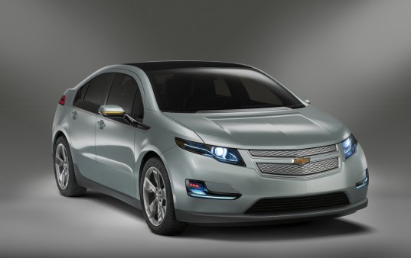

Types of Electric Vehicles
Hybrid Electric Vehicle (HEV)
Plug-in Hybrid Electric Vehicle (PHEV)
Plug-in Electric Vehicle (PEV or EV)

Slide 7
Method for Comparison
Calculate the CO₂ Emissions of both a gas powered car and an electric car
Assumptions:
Electric Car: Nissan Leaf
Gas Car: generic car with average gas mileage

Slide 8
Manufacturing-Related Emissions
Gas Powered Vehicle:
12,000 lbs CO₂ per car
Electric Vehicle:
28,000 lbs CO₂ per car
Main difference: internal combustion engine vs. lithium ion battery

Slide 9
Gas Powered Vehicle Emissions
Assume:
19.4 lbs CO₂ per gallon of gasoline
22.4 miles per gallon

Slide 10
Electricity Sources
Coal | 44.9%
Natural Gas | 23.4%
Nuclear | 20.3%
Hydroelectric | 6.9%
Other | 4.5%
Emissions:
Coal: 2.17 lbs CO₂ per kWh produced
Natural Gas: 1.40 lbs CO₂ per kWh produced
Assume zero emissions for other sources
Average US CO₂ emissions from electricity:
(2.17)(0.449) + (1.4)(0.234) = 1.30 lbs CO₂ per kWh produced

Slide 11
Electric Vehicle Emissions
Assume:
34 kWh per 100 miles
80% Efficiency
(34 kWh)/0.80 = 42.5 kWh needed to travel 100 miles

Slide 12
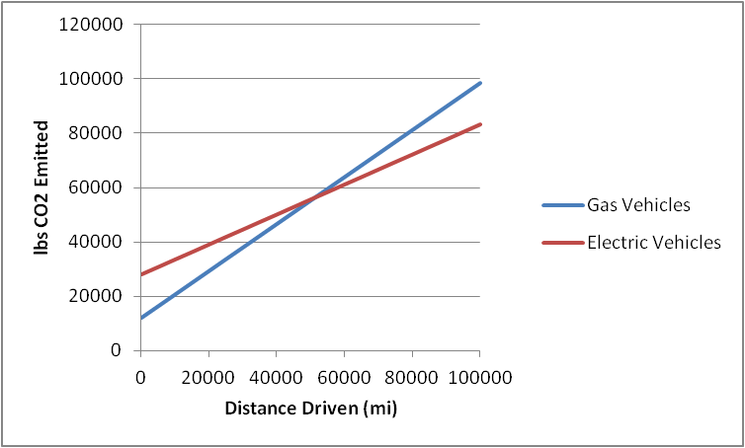
Breakeven point: 51,000 miles driven

Slide 13
What if…
All of your electricity comes from coal?
2.17 lbs CO₂ per kWh produced
0.922 lbs CO₂ per mile driven
Remember, gas powered cars produce 0.866 lbs CO₂ per mile driven
In this situation, gas powered vehicles have a smaller carbon footprint than electric vehicles

Slide 14
What if…
50% of your electricity is from renewable resources?
33% from coal, 17% from national gas
0.954 lbs CO₂ per kWh produced
0.405 lbs CO₂ per mile driven
Breakeven point with gas powered vehicles: 35,000 miles driven

Slide 15
What if…
You live in Wisconsin?
63% from coal, 9% from natural gas
1.49 lbs CO₂ per kWh produced
0.635 lbs CO₂ per mile driven
Breakeven point with gas powered vehicles: 69,000 miles driven

Slide 16
Economic Analysis
54% of people are willing to consider buying an electric vehicle
Only 9% willing to pay more than $2,000 extra for an EV
Current cost for a Nissan Leaf: $35,200
Average cost of a new car: $29,000

Slide 17
Fuel Cost Comparison
Average Gas Price: $3.80 per gallon
Average Electricity Price: $0.12 per kWh

Slide 18
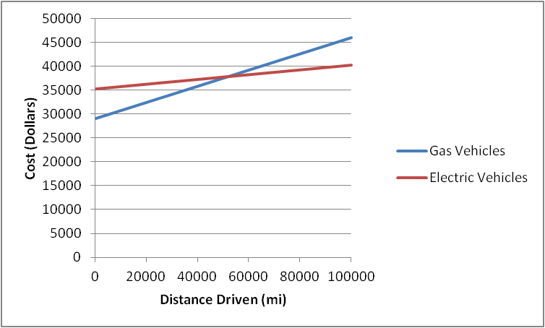
Breakeven Point: 52,000 miles driven

Slide 19
Possible Future Advances
Improve battery technology
Increase battery life
Increase range per charge
Decrease emissions from manufacturing process
Decrease CO₂ emissions from electricity
Increase usage of nuclear and renewable fuels
Clean Coal?
Very politically-charged topic
Other ideas?

Slide 20
Questions?

